Slide 1




⁴⁰Ar-³⁹Ar Dating of Apollo Impact Melts- Searching for Imbrium
L. B. Seifert, D. A. Kring, and T. D. Swindle
NASA Space Grant Symposium Tempe, AZ
April 21-22, 2017

Slide 2
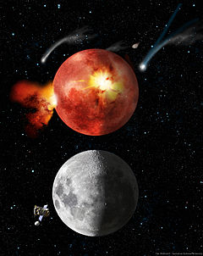
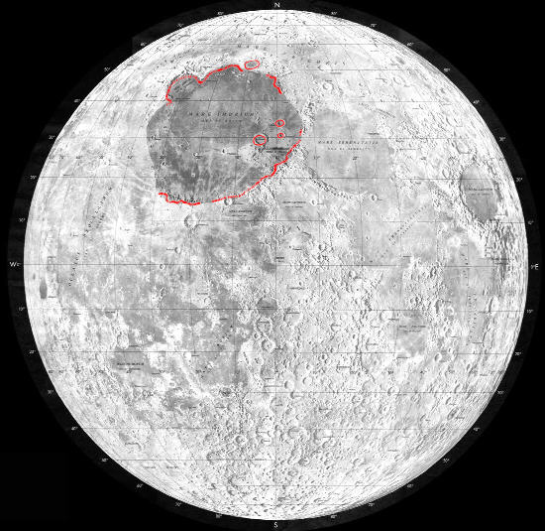

Background
Late Heavy Bombardment
  Controversial theory that during the period 3.8-4.1Ga, the terrestrial planets were heavily bombarded by asteroids
Imbrium Basin
  One of the largest impact craters on the Moon
  Landing site for Apollo 15, 17
  Thought to have formed during the Late Heavy Bombardment
    Age ~3.9-4.0Ga
https://commons.wikimedia.org/wiki/File:Imbrium_location.jpg
https://en.wikipedia.org/wiki/Late_Heavy_Bombardment

Slide 3
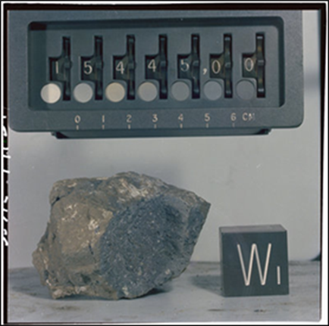
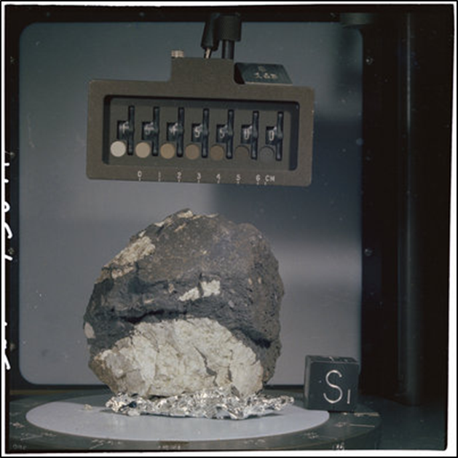
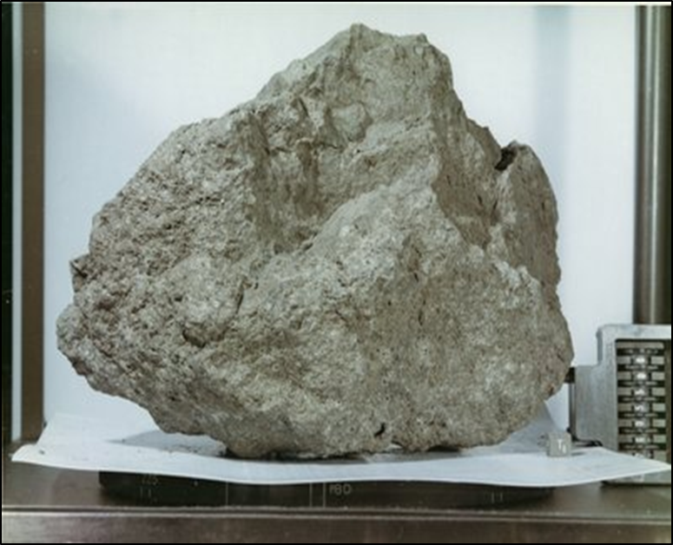

Objectives
Apollo 15
  Landing site: Hadley–Apennine- eastern edge of Imbrium basin
  Determine a more definitive age for Imbrium impact
Apollo 17
  Landing site: Taurus–Littrow- southern edge of Mare Serenitatis, east of Mare Imbrium
  Determine if it is fact Imbrium in nature or from the nearby Sculptured Hills formation
Apollo 15: 15445
Apollo 15: 15455
Apollo 17: 76055

Slide 4
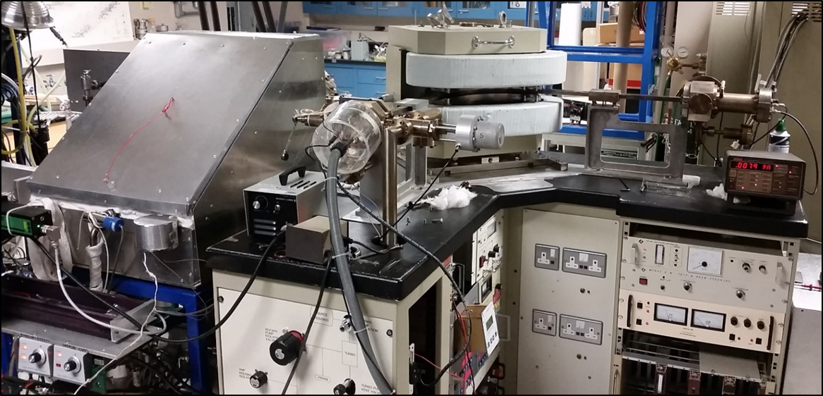

Methods
⁴⁰Ar-³⁹Ar technique
  Based on the decay of radioactive ${}_{}^{40}K$ to ${}_{}^{40}{Ar}$(half-life 1250Ma)
Neutron irradiation from a nuclear reactor to convert stable ${}_{}^{39}K$into the radioactive ${}_{}^{39}{Ar}$
A standard of known age is co-irradiated with unknown samples
Use a single measurement of argon isotopes to calculate the${}_{}^{40}K$/${}_{}^{40}{Ar∗}$ ratio, to calculate the age of the lunar sample
  ${}_{}^{40}{Ar∗}$ refers to the ${}_{}^{40}{Ar}$ produced from radioactive decay of ${}_{}^{40}K$

Slide 5
Apollo 15 Results
Sample 15445
Diffusion pattern
Substantial loss of gas around 1250Ma
Highest age is the lower limit of crystallization
Definitive age difficult to determine
  Likely an underestimate based on gas loss

Slide 6
Apollo 15 Results
Sample 15455
Diffusion pattern
Substantial gas loss ~1500Ma
Age also difficult to determine

Slide 7
Apollo 15 Conclusions
Both splits of sample 15445 contain distinctive diffusion patterns, with a large portion of gas being lost in the early steps
  Suggests a single, prominent heating event at ~1250Ma for both splits
  Definitive age difficult to determine- lack of plateau
The other Apollo 15 sample, 15455,28,BS39, also displays substantial outgassing at ~1250Ma, still an underestimate of the true age of the sample
  Consistent with Imbrium formation

Slide 8
Apollo 17 Results
Sample 76055
Only sample with strong plateau
Two very different ages
  3.930Ga vs. 4.003Ga

Slide 9
Apollo 17 Conclusions
76055 splits BS42/43 give an encouraging plateau like structure
Distinctly different ages
  One within the rage for Imbrium, one a bit too old
Suggests that 76055 is not the product of the Imbrium Impact
  Probably ejected from another region
  Different impact event

Slide 10
^{Thank You}

